Slide 1
PHARMACY MANAGEMENT SYSTEM💊

Slide 2

FRONT END: JAVA SWING BACKEND: JAVA CONNECTED USING: JDBC CONNECTOR DATABASE: MYSQL

Slide 3
AIM: To store data and enable functionality that organizes and maintains the medication use process within pharmacies
AUTHORIZED
USER
ADMIN
USER

Slide 4
MODULES
ADD MEDICINE
SELL MEDICINE
VIEW MEDICINE
ABOUT
LOCATION
HELP

Slide 5
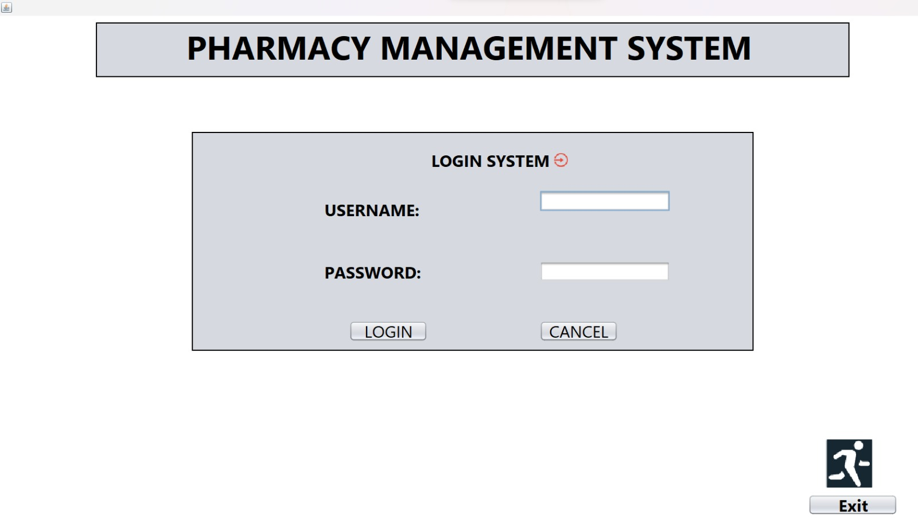
LOGIN PAGE
String sql= "select * from login ";
PreparedStatement ps=conn.prepareStatement(sql);
ResultSet rs=ps.executeQuery();

Slide 6
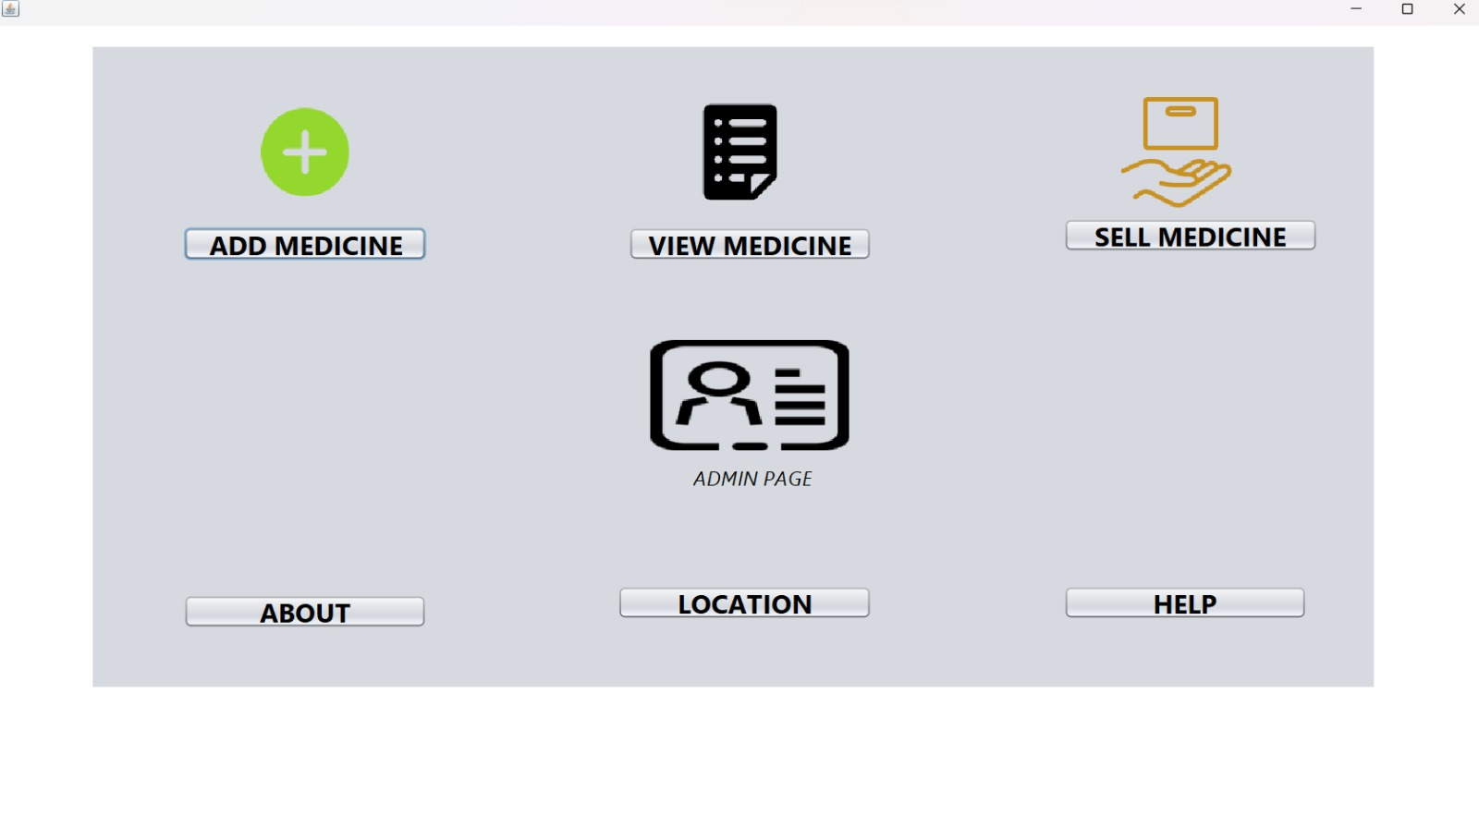
ADMIN PAGE
ADMIN USERNAME : Admin
ADMIN PASSWORD: Admin@123
setVisible(true):
1. Add Medicine
2. View Medicine
3.Sell Medicine
4.About
5.Location
6.Help

Slide 7
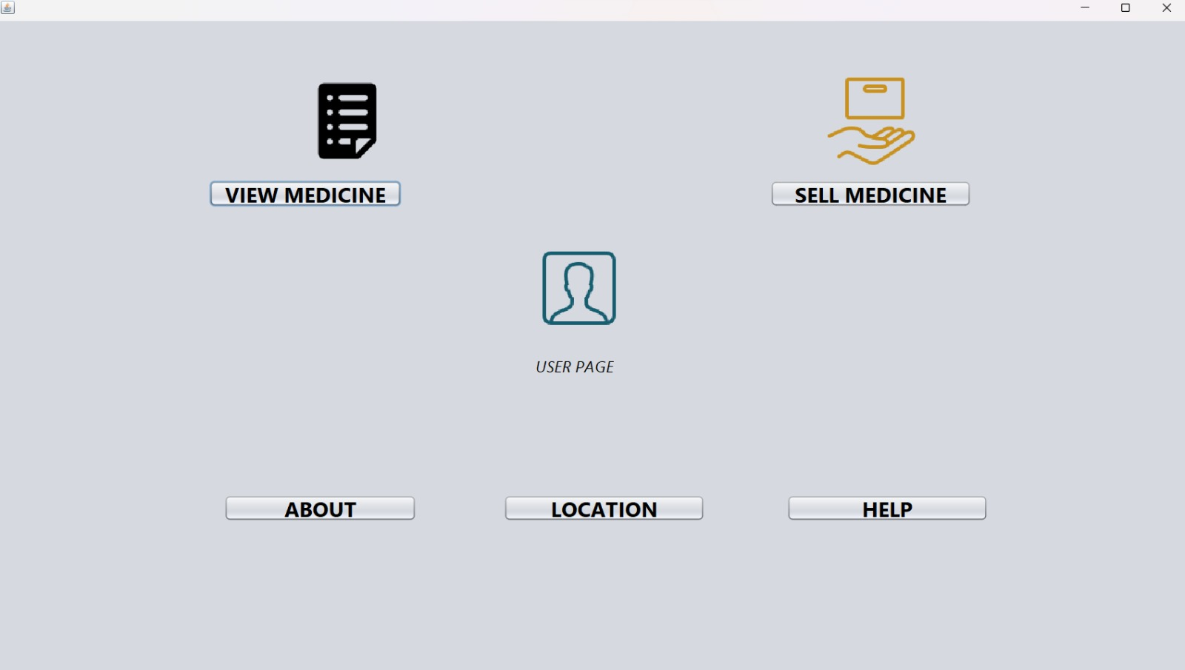
USER PAGE
USERNAME : user
PASSWORD: user
setVisible(true);
1. View Medicine
2.Sell Medicine
3.About
4.Location
5.Help

Slide 8
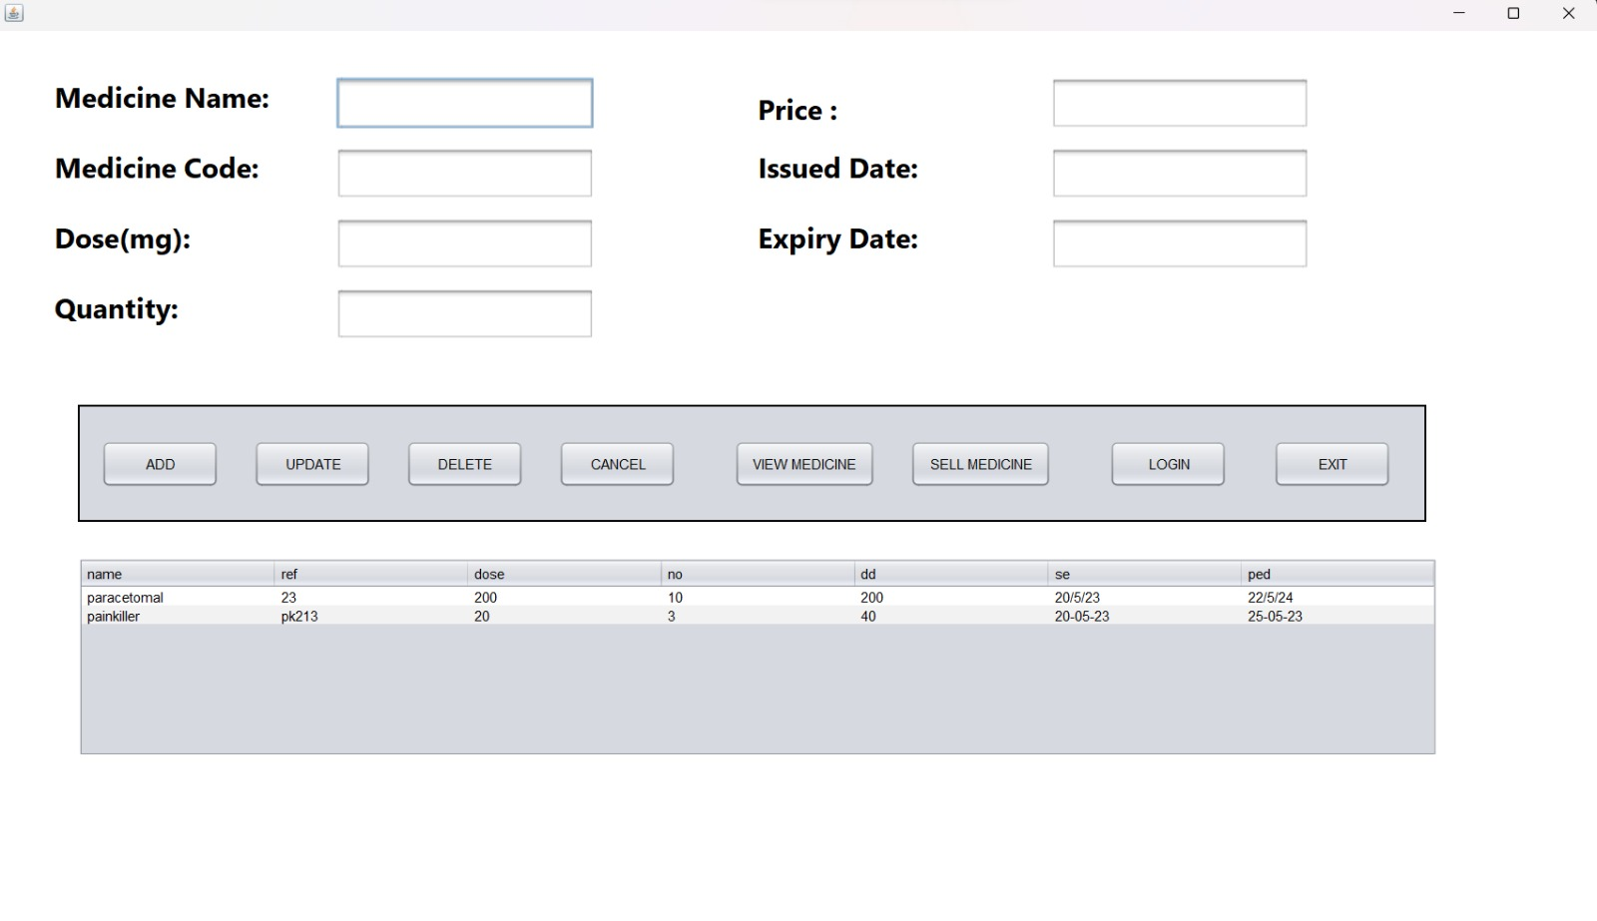
ADD MEDICINE
String sql= "select * from pharm ";
PreparedStatement ps=conn.prepareStatement(sql);
ResultSet rs=ps.executeQuery();
jTable1.setModel(DbUtils.resultSetToTableModel(rs));
PreparedStatement ps=conn.prepareStatement("Delete from pharm where ref=?");
ps.setString(1,ref);
ps.executeUpdate();
JOptionPane.showMessageDialog(this,"Deleted");
DisplayTable();
String sql = "insert into pharm values(?,?,?,?,?,?,?)";
PreparedStatement ps=conn.prepareStatement(sql); ps.setString(1,jtxtName.getText());
ps.setString(2,jtxtRef.getText());
ps.setString(3,jtxtDose.getText()); ps.setString(4,jtxtNumberTablets.getText()); ps.setString(5,jtxtDailyDose.getText()); ps.setString(6,jtxtPossibleSideEffects.getText()); ps.setString(7,jtxtPharmID.getText());
ps.executeUpdate();
JOptionPane.showMessageDialog(this,"Saved");

Slide 9
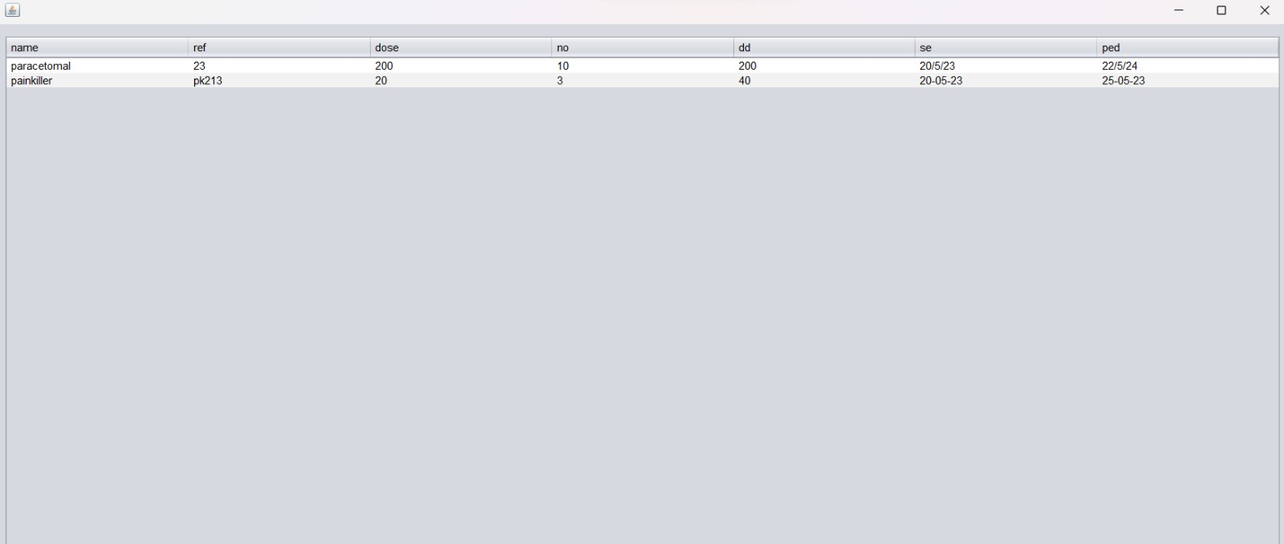
VIEW MEDICINE
String sql= "select * from pharm ";
PreparedStatement ps=conn.prepareStatement(sql);
ResultSet rs=ps.executeQuery(); jTable1.setModel(DbUtils.resultSetToTableModel(rs));
PreparedStatement ps=conn.prepareStatement("Delete from sell where MCode=?");
ps.setString(1,MCode);
ps.executeUpdate(); JOptionPane.showMessageDialog(this,"Deleted");
String sql = "insert into sell values(?,?,?,?,?,?,?)"; PreparedStatement ps=conn.prepareStatement(sql); ps.executeUpdate(); JOptionPane.showMessageDialog(this,"Saved");

Slide 10
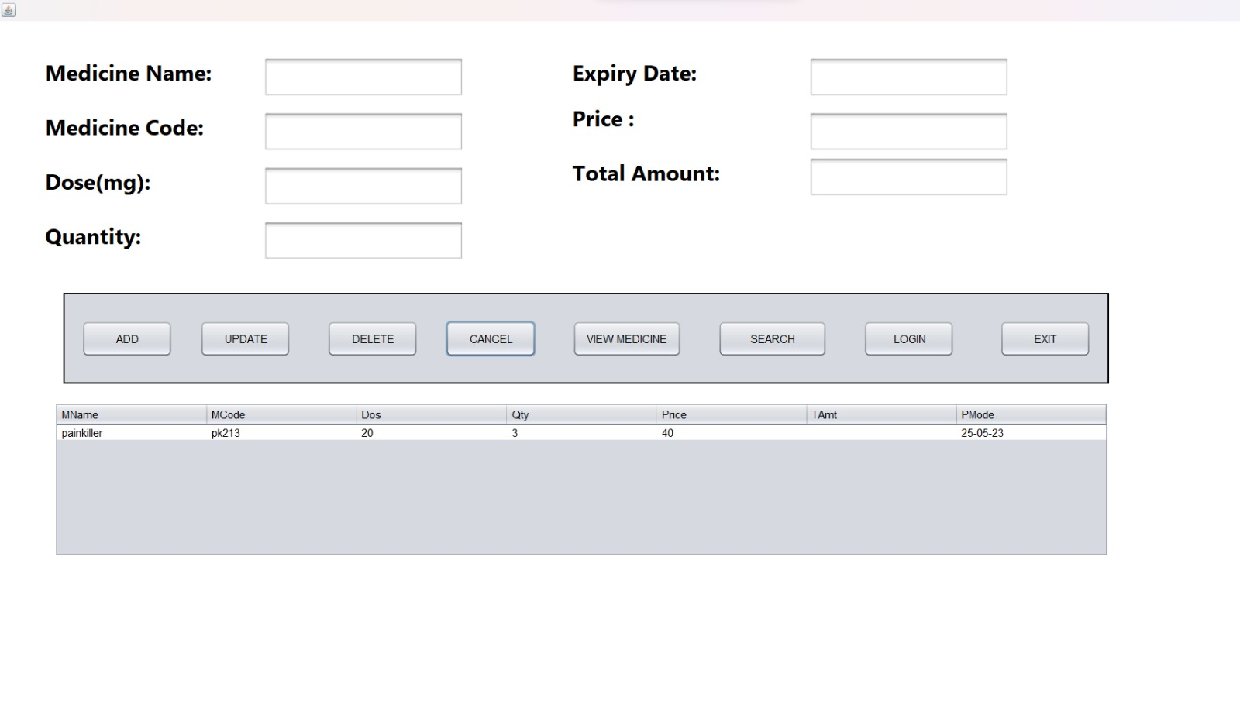
SELL MEDICINE
String sql= "select * from sell ";
PreparedStatement ps=conn.prepareStatement(sql);
ResultSet rs=ps.executeQuery();
jTable2.setModel(DbUtils.resultSetToTableModel(rs));
String sql = "insert into sell values(?,?,?,?,?,?,?)";
PreparedStatement ps=conn.prepareStatement(sql);
ps.setString(1,jtxtName.getText());
ps.setString(2,jtxtRef.getText());
ps.setString(3,jtxtDose.getText());
ps.setString(4,jtxtNumberTablets.getText());
ps.setString(5,jtxtDailyDose.getText());
ps.setString(6,jtxtPossibleSideEffects.getText());
ps.setString(7,jtxtPharmID.getText());
ps.executeUpdate();
JOptionPane.showMessageDialog(this,"Saved");
PreparedStatement ps=conn.prepareStatement("Delete from sell where MCode=?");
ps.setString(1,MCode);
ps.executeUpdate();
JOptionPane.showMessageDialog(this,"Deleted");
DisplayTable();

Slide 11
SEARCH BUTTON
String sql = "select * from pharm where name=? and dose=?";
PreparedStatement ps=conn.prepareStatement(sql);
ps.setString(1,jtxtName.getText());
ps.setString(2,jtxtDose.getText());
ResultSet rs = ps.executeQuery();
if(rs.next())
{
JOptionPane.showMessageDialog(this,"MEDICINE AVAILABLE");
jtxtName.setText(rs.getString("name"));
jtxtRef.setText(rs.getString("ref"));
jtxtPharmID.setText(rs.getString("ped"));
jtxtDailyDose.setText(rs.getString("dd"));
}
else
{
JOptionPane.showMessageDialog(this,"MEDICINE NOT AVAILABLE");
}
} catch (SQLException ex) {
java.util.logging.Logger.getLogger(Patient.class.getName()).log(java.util.logging.Level.SEVERE, null, ex);
}

Slide 12
CANCEL BUTTON
jtxtName.setText("");
jtxtRef.setText("");
jtxtDose.setText("");
jtxtNumberTablets.setText("");
jtxtDailyDose.setText("");
jtxtPossibleSideEffects.setText("");
jtxtPharmID.setText("");

Slide 13
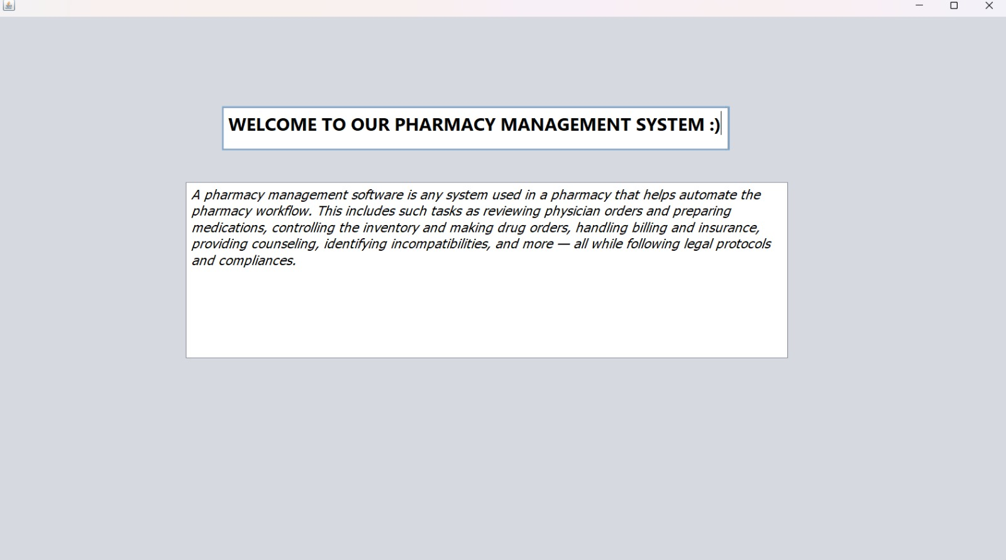
ABOUT

Slide 14
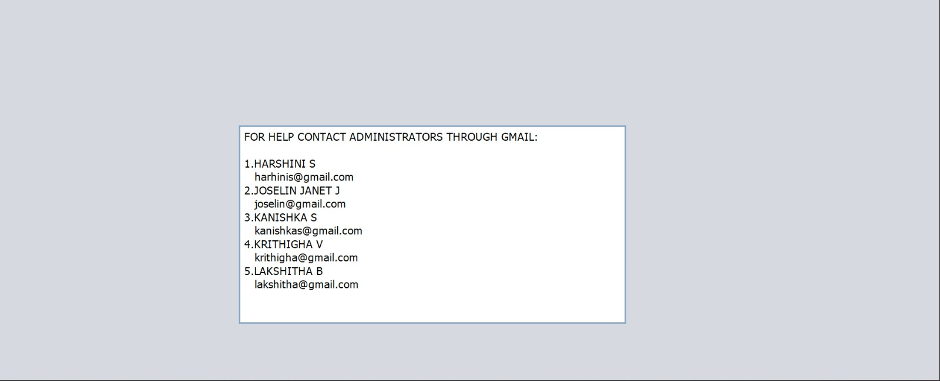
HELP

Slide 15
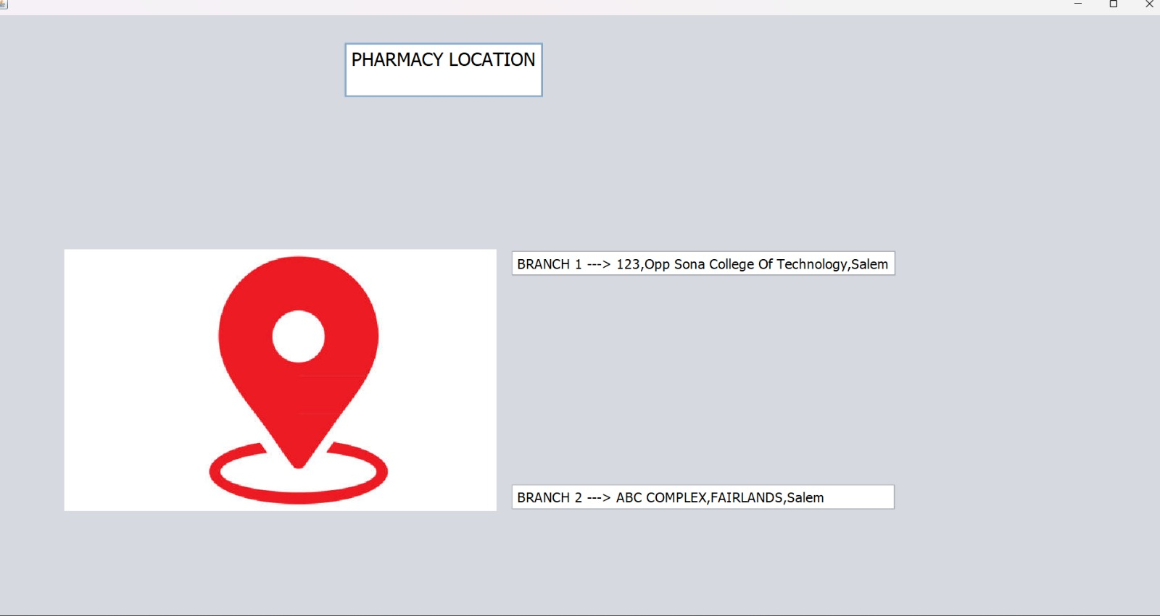
LOCATION

Slide 16

DATABASE
try {
Class.forName("com.mysql.cj.jdbc.Driver");
} catch (ClassNotFoundException ex) {
Logger.getLogger(pharmacy.class.getName()).log(Level.SEVERE, null, ex);
}
String url = "jdbc:mysql://localhost:3306/pharmacy";
Connection conn = null
try{
String ref=jtxtRef.getText();
conn = DriverManager.getConnection(url,"root","Pharm@123");
}catch (SQLException ex) {
Logger.getLogger(pharmacy.class.getName()).log(Level.SEVERE, null, ex);
}
}

Slide 17
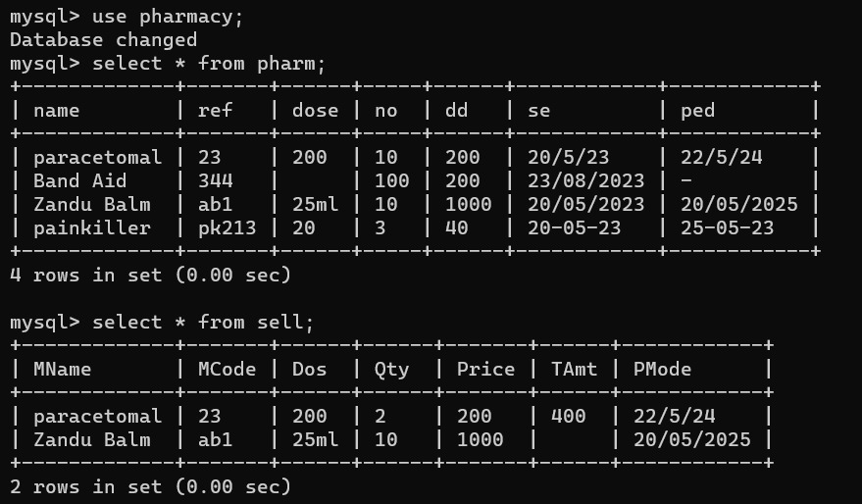
DATABASE

Slide 18

THANK YOU

